Slide 1
Insurance Benefits
2023- 2024

Slide 2
Insurance Contact
Angie Pike
Accounting and Benefits Specialist
Phone: 585-586-0790
Fax: 585-586-0790
Anjanette.pike@medscribe.com

Slide 3
Disclaimer
This presentation is a summary and explanation of your benefits.
Please refer to your group benefit contract and benefit booklet for the complete terms, conditions, and exclusions of the group benefit program.
If there are any discrepancies between the information presented in the following slides and the Benefit Contracts, Summary of Benefits
and Coverage, and/or Benefit Summaries, the Benefit Contracts, Summary of Benefits and Coverage, and/or Benefit Summaries shall prevail.

Slide 4
2023 - 2024 Group Insurance Benefits
Medical *NEW PLAN
Dental
Vision
HSA *NEW

Slide 5
Medical

Slide 6
Comparison of Medical Insurance
Coverage | Excellus Signature Hybrid $25 | Excellus Signature High Deductible A | Excellus Signature High Deductible B *NEW
Deductible & Out of Pocket Max
Deductible Single/Family | $1,000 / $3,000 | $3,000 / $6,000 | $6,550 / $13,100
Co-Insurance | 20% | 0% | 0%
Out of Pocket Maximum | $3,000 / $9,000 | $5,000 / $10,000 | $6,550 / $13,100
Out of Network Coverage | Yes | Yes | Yes
Preventative Services
Adult Physicals OB/GYN Cancer Screenings Immunizations Well Child Visits | COVERED IN FULL
Office Visits
Primary Care Physician / Specialist | $25 Copay / $40 Copay | Covered at 100%, subject to deductible | Covered at 100%, subject to deductible
Urgent Care | $40 Copay | Covered at 100%, subject to deductible | Covered at 100%, subject to deductible
Telemedicine | Covered in full | Covered at 100%, subject to deductible | Covered at 100%, subject to deductible
Emergency Room | $200 Copay | Covered at 100%, subject to deductible | Covered at 100%, subject to deductible
Inpatient & Outpatient Services
Inpatient Hospitalization | Covered at 80%, subject to deductible | Covered at 100%, subject to deductible | Covered at 100%, subject to deductible
Outpatient Surgical | Covered at 80%, subject to deductible | Covered at 100%, subject to deductible | Covered at 100%, subject to deductible
Prescription Drug Coverage
RX Deductible | N/A | Subject to deductible (Except Preventive Rx) | Subject to deductible (Except Preventive Rx)
Generic | $10 | $10 | $0
Brand | $30 | $30 | $0
Non-Formulary | $50 | $50 | $0

Slide 7
Health Savings Account (HSA)
Who is Eligible?
To set-up an HSA and contribute funds, you must be covered by a qualified high deductible health plan (HDHP).
What is an HSA Account?
An HSA allows you to pay for current and future qualified medical expenses on a tax‑favored basis.
Tax-deductible contribution
Tax-deferred earnings
Tax-free withdrawals
This Photo by Unknown Author is licensed under CC BY

Slide 8
Annual Health Savings Account Contribution Limits
YEAR | INDIVIDUAL | FAMILY | CATCH-UP Contributions (Age 55+)
2023 | $3,850 | $7,750 | $1,000
2024 | $4,150* | $8,300* | $1,000

Slide 9
Qualified Medical Expenses
The money in the account can be used to pay for “qualified medical expenses” for yourself, your spouse, or your tax qualified dependent children (even if spouse and children are not covered by your High Deductible Health Plan)
Deductible
Co-Pays and Coinsurance
Dental
Eye Care
Prescribed Medications
Over-the-Counter Medications (CARES Act)
Any amounts used for other purposes (not qualified) are taxable as income and subject to an additional 20% tax penalty (until age 65, death or disability)
This Photo by Unknown Author is licensed under CC BY

Slide 10
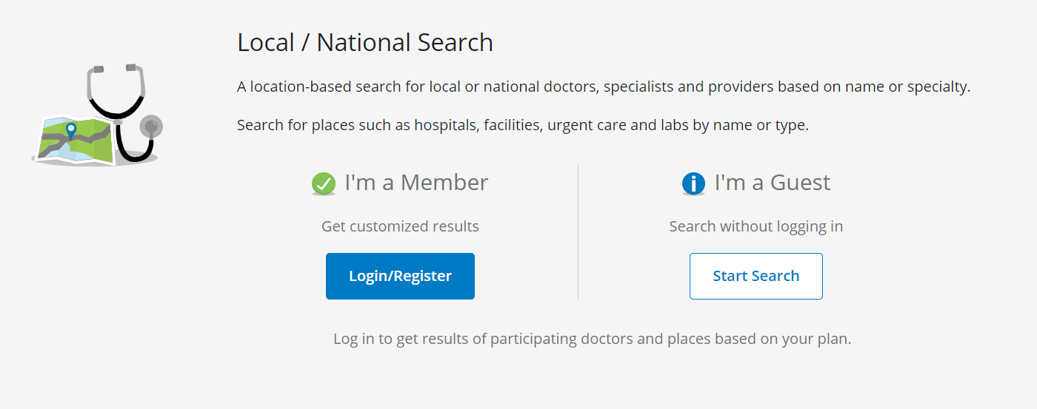
Excellus BlueCross BlueShield
https://www.excellusbcbs.com/find-a-doctor/provider
This Photo by Unknown Author is licensed under CC BY

Slide 11
Dental

Slide 12
Dental Insurance
Coverage | Excellus Dental Blue Options
Deductible Single/Family | $50 Single / $150 Family
Annual Max Per Person | $1,000
Dependent Age | 26 / 26
Waiting Periods | None for timely entrants
Out of Network Coverage | 90% UCR
Preventive Services
Oral exam | Covered at 100%
Cleanings
X-Rays
Fluoride for Children
Basic Service
Fillings | Covered at 80%, subject to deductible
Root Canal
Major Service
Crowns | Covered at 50%, subject to deductible
Dentures
Ortho
Orthodontia (up to age 19) | Covered at 50% up to $1,000 per lifetime maximum

Slide 13
Dental Insurance Employee Cost
Plan Name | Excellus Dental
Tier | 2023 - 2024 Employee Cost Per Pay Period
Employee | $9.38
Employee + Spouse | $18.77
Employee + Child(ren) | $17.19
Family | $28.65
This Photo by Unknown Author is licensed under CC BY-SA-NC

Slide 14
Vision

Slide 15
Vision Insurance
Coverage | Excellus Simply Vision
 | Davis Vision Network
Eye Exam Copay | $10
Materials Copay | $25
Frames Allowance | $130 Max Allowance ($180 Allowance at Visionworks)
Contacts Allowance | 4 boxes - Disposable
Exam Frequency | Once Every 12 Months
Lens Frequency | Once Every 12 Months
Frame Frequency | Once Every 12 Months
Tier | 2023 - 2024 Employee Cost Per Pay Period
Employee | $1.60
Employee + Spouse | $2.88
Employee + Child(ren) | $3.05
Family | $4.81

Slide 16
Thank You. Please contact your recruiter with any questions.

